Slide 1

Goodbye Renderers, Hello Handlers
Alejandro Ruiz
Microsoft MVP: Developer Technologies

Slide 2
¿Handlers?
With .NET MAUI Custom Renderers are evolving into Handlers.
Custom Handlers is the new way to extend existing MAUI controls and/or to create new native controls.

Slide 3
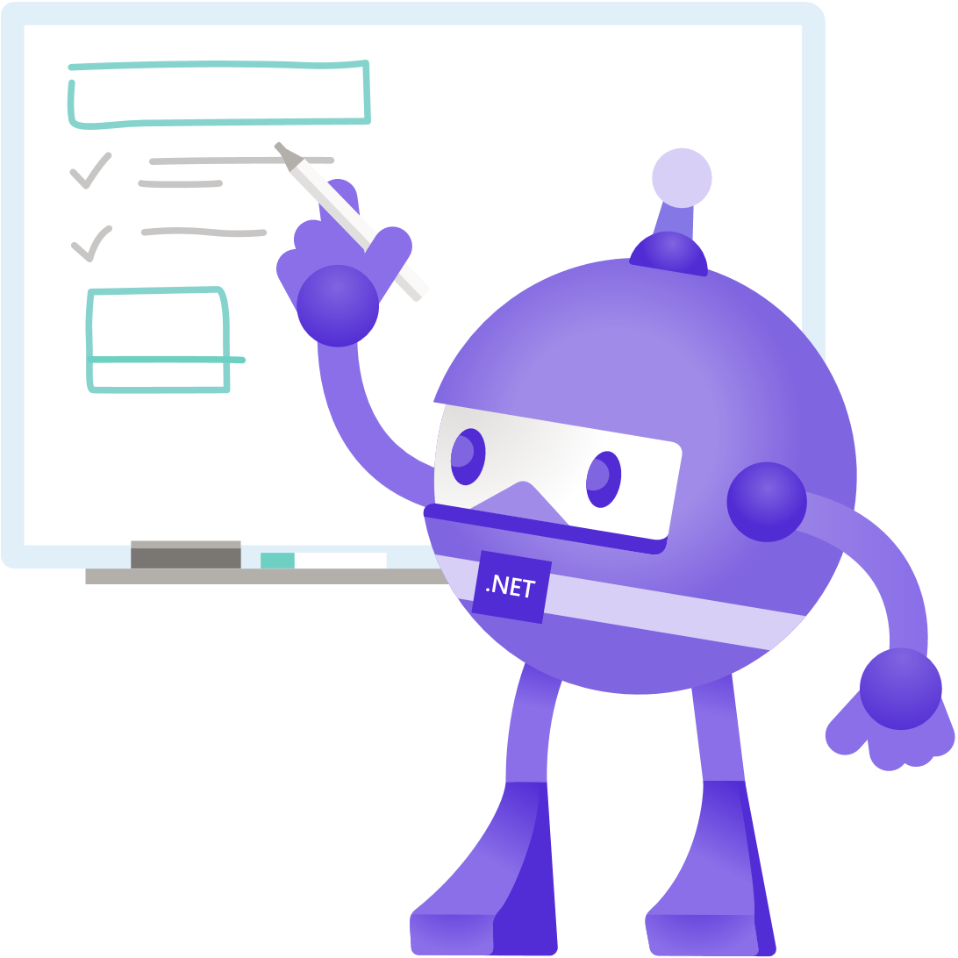
Issues with Xamarin.Forms

Slide 4
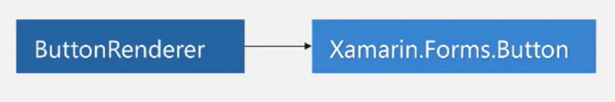
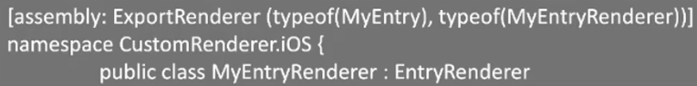
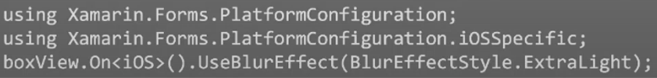
Root issues with the Xamarin.Forms architecture
Custom controls tied to the framework.
Assembly scanning impact the app performance.
Complex way to access native APIs.

Slide 5
Why handlers got introduced on .NET MAUI
Performance.
Improvements with IoC, avoid Reflection and assembly scanning, layout improvements, and all handlers are “fast renderers”
API Improvements
Access to the Native APIs is complex, Handlers offers a simple way to consume platform specific APIs.
Simple
Project structure is simple compared with Custom Renderers, and avoid creating unneeded views.

Slide 6
.NET MAUI Goals

Slide 7
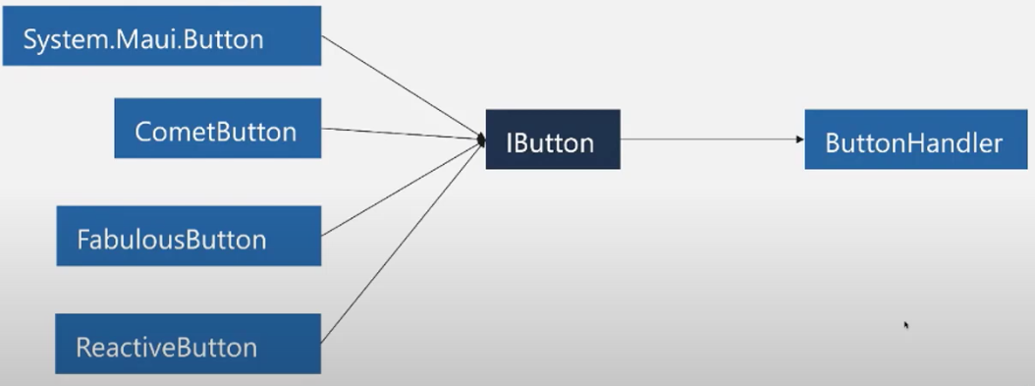
Remove framework dependency
Framework dependency removed.
Performance improvements.
Simplify register.
Remove confuse platform specifics APIs / assembly registration.

Slide 8
Terminology

Slide 9
Custom Renderer -> Custom Handler
We have new terms but similar to the ones used for custom renderers:
Element -> VirtualView – Contains the cross platform definition for a visual component.
Control -> PlatformView – Native control.
Mapper -> Map of properties to native implementations.
Handler -> Handle all the changes made to the VirtualView and apply the native implementation in comparision with Custom Renderers is basically the OnElementPropertyChanged method.

Slide 10
Custom Renderer -> Custom Handler
New terms
CreatePlatformView – this Method allows to generate the instance of the native control.
ConnectHandler – this Method allows to initialize our native control.
DisconnectHandler – this Method can be used to free resources, handlers, delegates, free memory, unload controls, etc.

Slide 11
How to generate a Custom Handler.

Slide 12
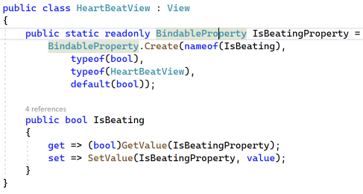
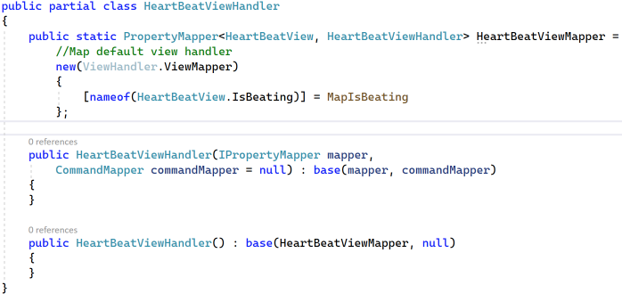
How to generate a Custom Handler
Create a new class with your control with the View o the component to extend Entry/Button/Image etc.
Create a partial ViewHandler class with a public static PropertyMapper member.

Slide 13
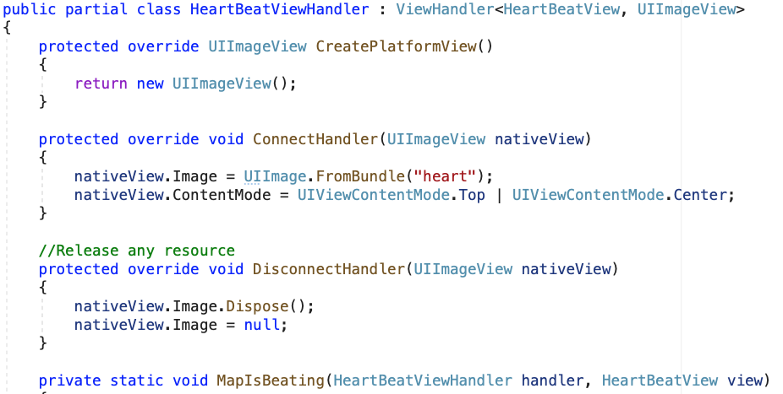
How to generate a Custom Handler
3. Create a the native implementation using the same name as the previous virtual ViewHandler class and within the same namespace also use the ViewHandler base type and set the proper Virtual / Native view types, and implement the CreatePlatformView, ConnectHandler and DisconnectHandler if needed.

Slide 14
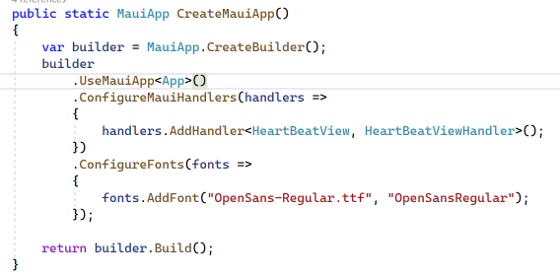
How to generate a Custom Handler
4. And as a last step don't forget to register the handler inside the MauiProgram with the ConfigureMauiHandlers builder’s method.

Slide 15

Demo
Custom Handlers

Slide 16


¡Thanks, Obrigado, Cпасибо!
Goodbye Renderers, Hello Handlers
Alejandro Ruiz
Microsoft MVP: Developer Technologies

